Slide 1
Evolutionary Computing – Genetic Algorithms
Soft Computing Applications

Slide 2
Limitations of the traditional optimization approaches
Limitations:
Computationally expensive.
For a discontinuous objective function, methods may fail. Method may not be suitable for parallel computing.
Discrete (integer) variables are difficult to handle. Methods may not necessarily adaptive.
Evolutionary algorithms have been evolved to address the above mentioned limitations of solving optimization problems with traditional approaches.
Soft Computing Applications

Slide 3
Objective:
After studying this unit you will be able to:
• Appreciate the genetic or evolutionary approaches as to why and how they have influenced the computing methods for problem solving;
• Describe Simple Genetic Algorithm (SGA), a limited exposure of the genetic operators;
• Define the genetic operators;
• Apply reproduction, crossover and mutation operators;
• Describe the traditional search methods;
• Define a simple genetic algorithm;
• Apply genetic algorithm to find better solution;
• List advantages and disadvantages.
Soft Computing Applications

Slide 4
Evolutionary Algorithms
The algorithms, which follow some biological and physical behaviors:
Biologic behaviors:
Genetics and Evolution –> Genetic Algorithms (GA) Behavior of ant colony –> Ant Colony Optimization (ACO) Human nervous system –> Artificial Neural Network (ANN)
In addition to that there are some algorithms inspired by some physical behaviors:
Physical behaviors:
Annealing process –> Simulated Annealing (SA)
Swarming of particle –> Particle Swarming Optimization (PSO) Learning –> Fuzzy Logic (FL)
Soft Computing Applications

Slide 5
Genetic Algorithm
It is a subset of evolutionary algorithm:
Ant Colony optimization Swarm Particle Optimization
Models biological processes:
Genetics Evolution
To optimize highly complex objective functions:
Very difficult to model mathematically
NP-Hard (also called combinatorial optimization) problems (which are computationally very expensive)
Involves large number of parameters (discrete and/or continuous)
Soft Computing Applications

Slide 6
Background of Genetic Algorithm
Firs time itroduced by Ptrof. John Holland (of Michigan University, USA, 1965).
But, the first article on GA was published in 1975.
Principles of GA based on two fundamental biological processes:
Genetics: Gregor Johan Mendel (1865)
Evolution: Charles Darwin (1875)
Soft Computing Applicatins

Slide 7
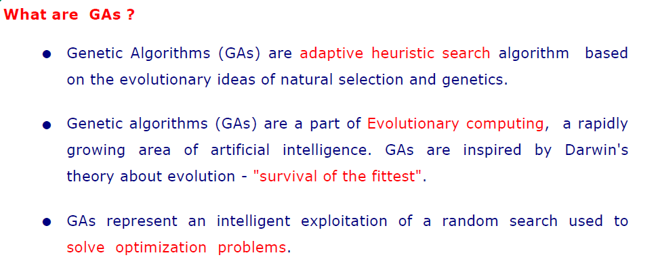

Slide 8

A brief account on genetics
The basic building blocks in living bodies are cells. Each cell carries the basic unit of heredity, called gene
Nucleus
Chromosome
Other cell bodies
For a particular specie, number of chromosomes is fixed.
Examples
Mosquito: 6
Frogs: 26
Human: 46
Goldfish: 94 etc.
Soft Computing Applications

Slide 9
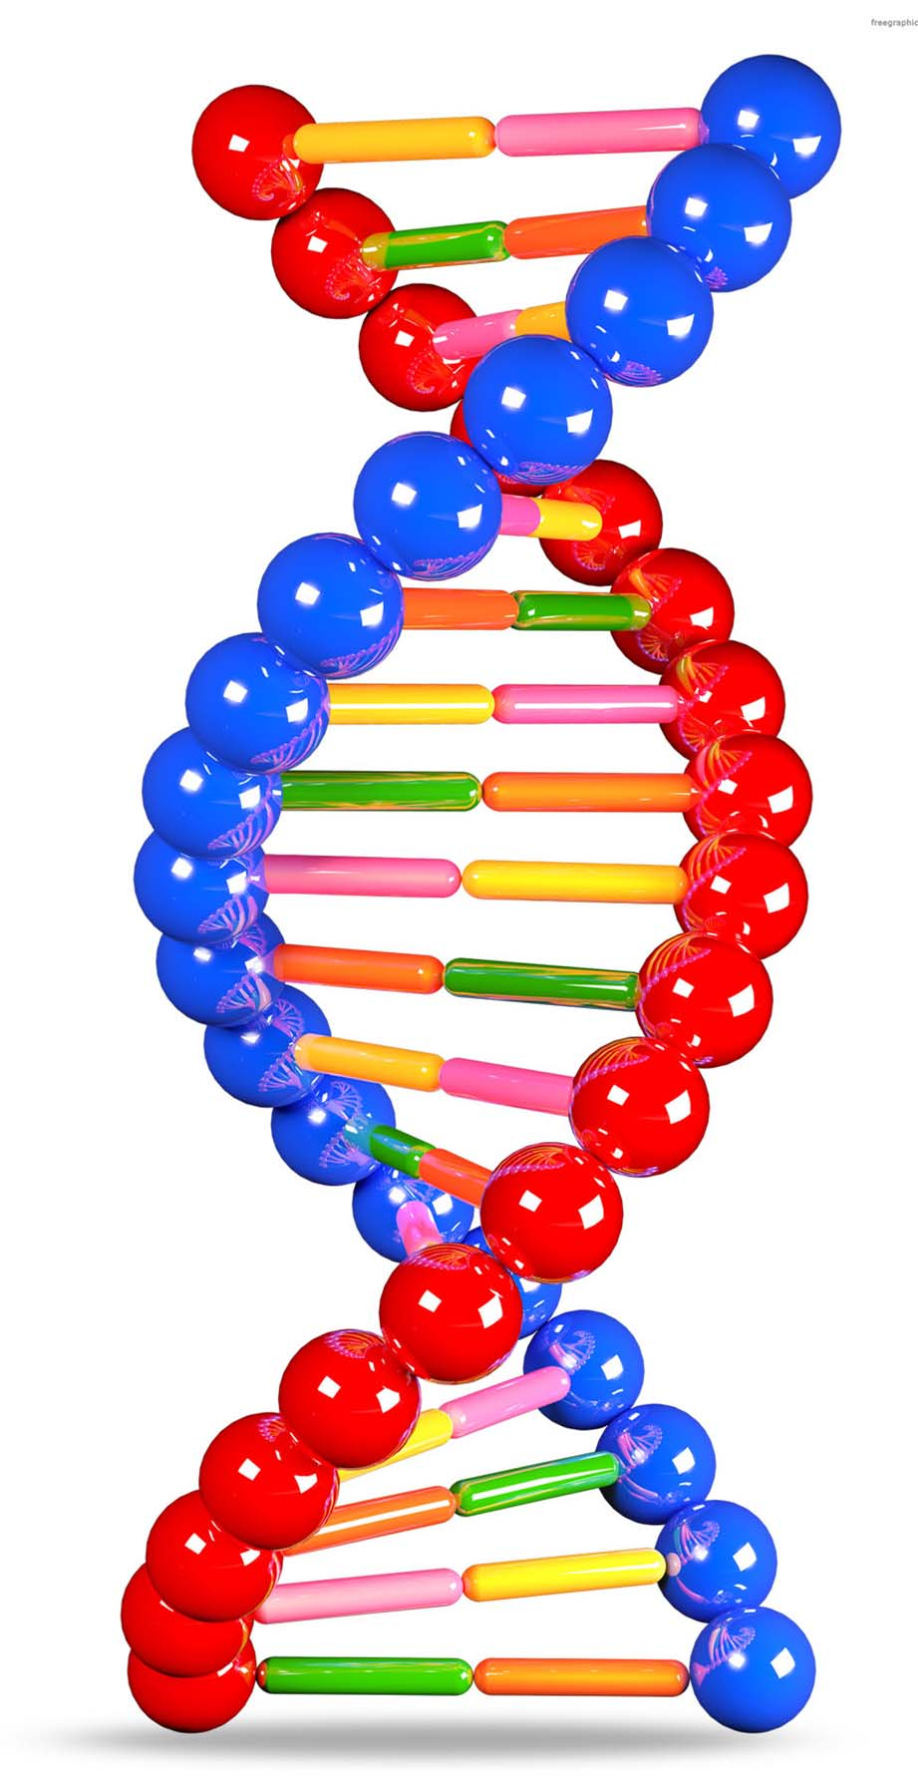
A brief account on genetics
Genetic code
Spiral helix of protein substance is called DNA.
For a specie, DNA code is unique, that is, vary uniquely from one to other.
DNA code (inherits some characteristics from one generation to next generation) is used as biometric trait.
Soft Computing Applications

Slide 10




A brief account on genetics
Reproduction
+
=
Organism’s cell : Cell division
x
y
gamete
diploid
(Reproductive cell has half the number of chromosomes)
Each chromosome from both haploids are combined to have full numbers
haploid
diploid
Soft Computing Applications

Slide 11
A brief account on genetics
Crossing over
Kinetochore
Information from two different organism’s body cells
Combined into so that diversity in information is possible
Random crossover points makes infinite diversities
Soft Computing Applications

Slide 12
A brief account on evolution
Evolution : Natural Selection
Four primary premises:
1
Information propagation: An offspring has many of its characteristics of its parents (i.e. information passes from parent to its offspring). [Heredity]
Population diversity: Variation in characteristics in the next generation. [Diversity]
Survival for exitence: Only a small percentage of the offspring produced survive to adulthood. [Selection]
Survival of the best: Offspring survived depends on their inherited characteristics. [Ranking]
2
3
4
Soft Computing Applications

Slide 13
A brief account on evolution
Mutation:
To make the process forcefully dynamic when variations in population going to stable.
Soft Computing Applications

Slide 14

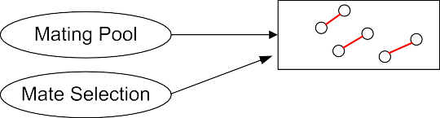
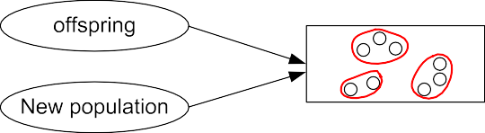
Biological process : A quick overview
Genetics
Soft Computing Applications

Slide 15
Working of Genetic Algorithm
Definition of GA:
Genetic algorithm is a population-based probabilistic search and optimization techniques, which works based on the mechanisms of natural genetics and natural evaluation.
Soft Computing Applications

Slide 16
Framework of GA
Start
Note:
An individual in the
Initial Population
population is corresponding to a possible solution
No
Selection
Converge ?
Yes
Reproduction
Stop
Soft Computing Applications

Slide 17
Working of Genetic Algorithm
Note:
GA is an iterative process. It is a searching technique.
Working cycle with / without convergence.
Solution is not necessarily guranteed. Usually, terminated with a local optima.
1
2
3
4
Soft Computing Applications

Slide 18
Framework of GA: A detail view
Start
Define parameters
Parameter representation
Initialize population
Create population
Apply cost
function to each of the population
No
Evaluate the fitness
Converge ?
S e l e c t i o n
Yes
Select Mate
Stop
Crossover
R e p r o d u c t i o n
Mutation
Inversion
Soft Computing Applications

Slide 19
Optimization problem solving with GA
For the optimization problem, identify the following:
Objective function(s) Constraint(s)
Input parameters
Fitness evaluation (it may be algorithm or mathematical formula) Encoding
Decoding
Soft Computing Applications

Slide 20
GA Operators
In fact, a GA implementation involved with the realization of the following operations.
Encoding: How to represent a solution to fit with GA framework.
Convergence: How to decide the termination criterion.
Mating pool: How to generate next solutions.
Fitness Evaluation: How to evaluate a solution. Crossover: How to make the diverse set of next solutions. Mutation: To explore other solution(s).
Inversion: To move from one optima to other.
1
2
3
4
5
6
7
Soft Computing Applications

Slide 21
Simple GA
Start
Create Initial population of size N
Evaluate each individuals
Convergence Criteria meet ?
Yes
Return the individual(s) with best fitness value
No
Select Np individuals (with repetition)
Stop
Create mating pool (randomly) (Pair of parent for generating new offspring)
Perform crossover and
create new offsprings
Reproduction
Mutate the offspring
Perform inversion on
the offspring
Replace all individuals in the last generation with new offsprings created
Soft Computing Applications

Slide 22
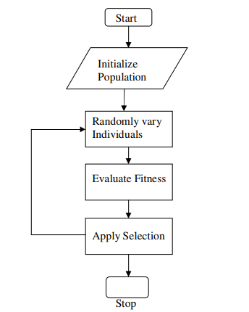
Salient features in SGA
Selection:
Soft Computing Applications

Slide 23
Salient features in SGA
A simple genetic algorithm procedure is given in the following steps.
Generation of a population of solution: In this, an encoding of solutions to the problem as a chromosome is done and a number, or population, of guesses of the solution to the problem are found.
Fitness evaluation: a way of calculating how good or bad (fitness) the individual solutions within the population are listed.
Reproduction: a method for mixing fragments of the better solutions (reproduction) to form new, on average even better solutions;
A mutation operator to avoid permanent loss of diversity within the solutions.
Soft Computing Applications

Slide 24
Encoding
Binary Encoding
Value Encoding
Permutation Encoding
Tree Encoding
Soft Computing Applications

Slide 25
Selection
Roulette Wheel Selection
Rank Selection
Tournament Selection
Soft Computing Applications

Slide 26
Crossover
One point Crossover
Two point Crossover
N point Crossover
Uniform Crossover
Soft Computing Applications

Slide 27
Mutation
Flip bit
Boundary
Non Uniform
Gaussian
Soft Computing Applications

